Slide 1
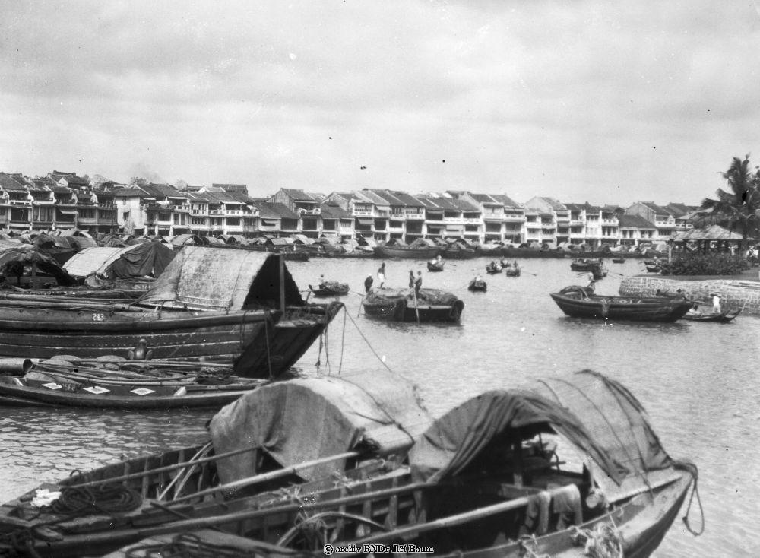
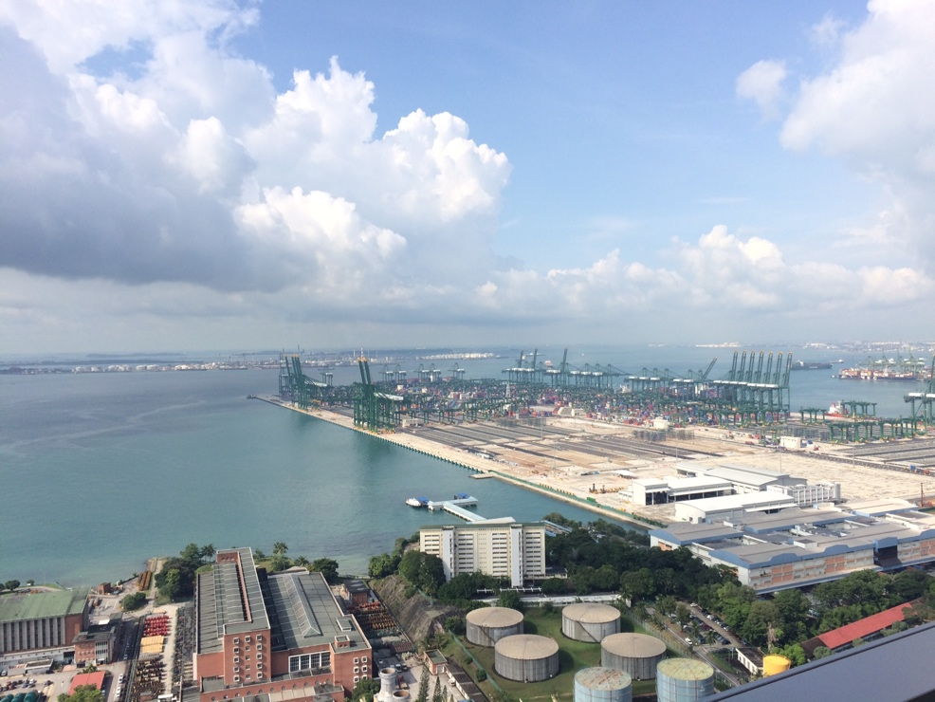
Singapore’s Business History
GES1009/SSA2203
Semester 2,
AY2018-19
Notes:
\

Slide 2
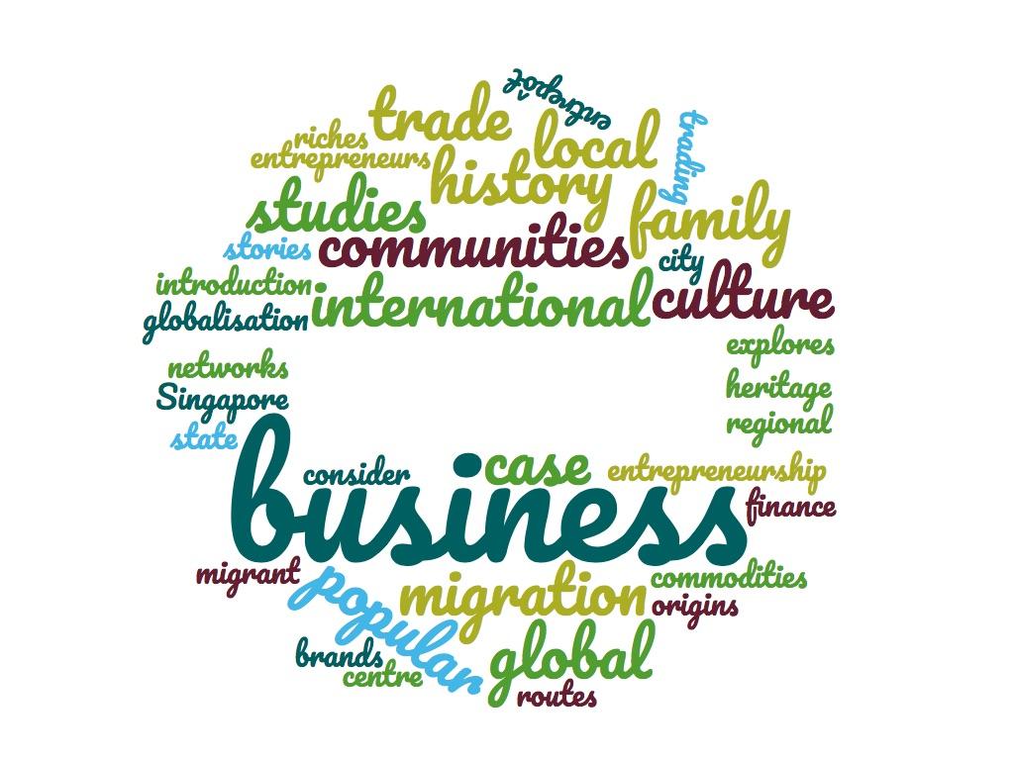
GES1009/SSA2203
Notes:
\

Slide 3

Your teaching team:
Assoc Prof. Medha Kudaisya
  hiskmm@nus.edu.sg
  Dr. Donna Brunero
  dbrunero@nus.edu.sg

Slide 4
Assessment:
Tutorial participation
Response paper
Heritage assignment/essay
Examination (OPEN BOOK!)
-

Slide 5
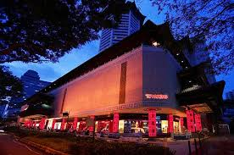
Crazy (?) Rich Asians…
The ‘rags to riches’ stories that inspire us!
But we need to go beyond this stereotype to learn more about Singapore’s business history…

Slide 6
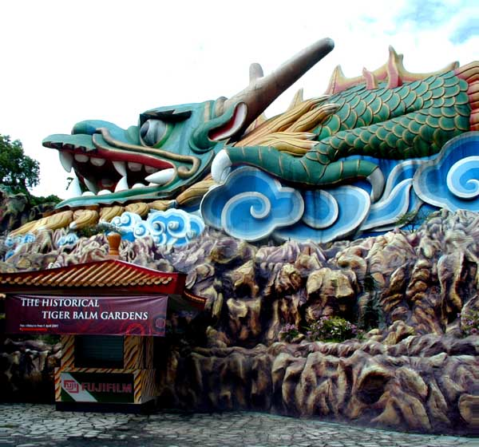
Approaches to Singapore’s Business History
Theoretical
Chronological
Thematic

Slide 7
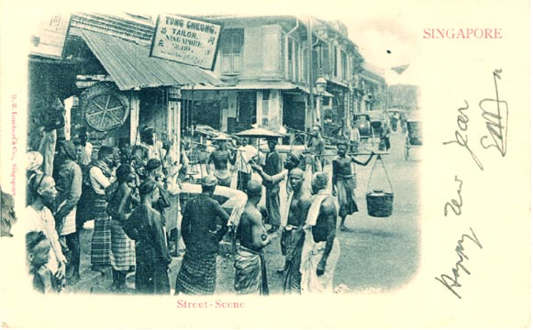
Migration and early business communities.

Slide 8

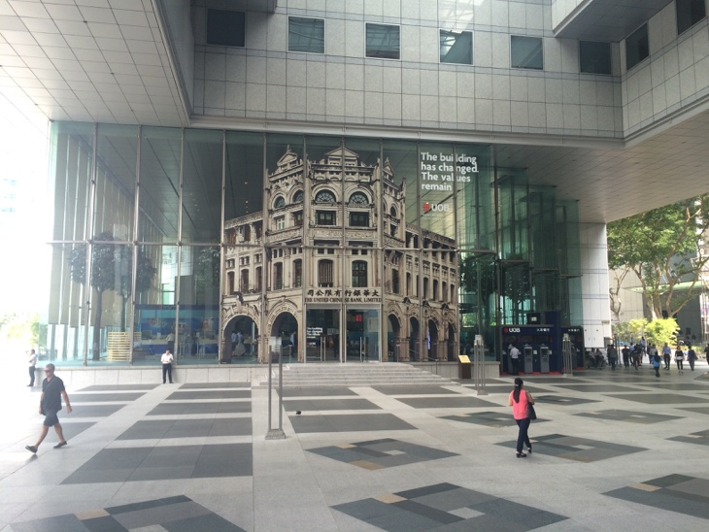
Development and key industries…

Slide 9
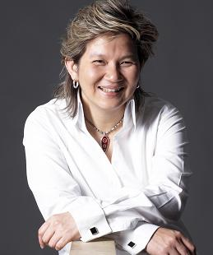
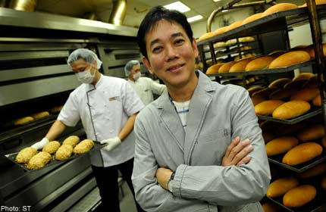
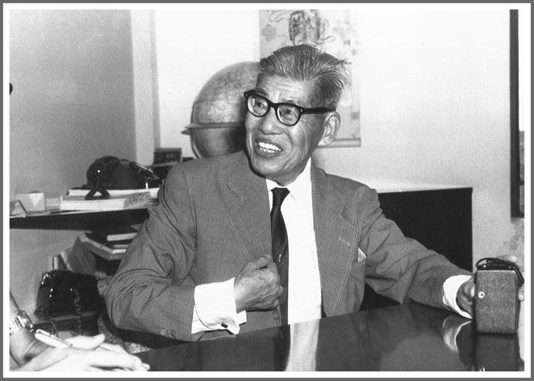
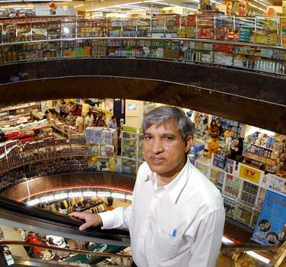

Entrepreneurship

Slide 10
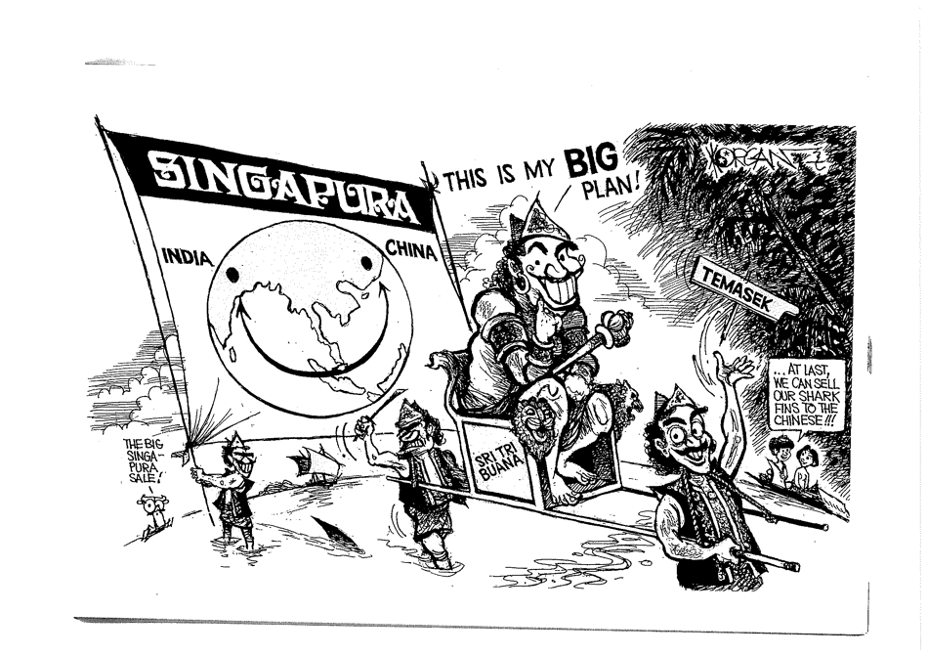
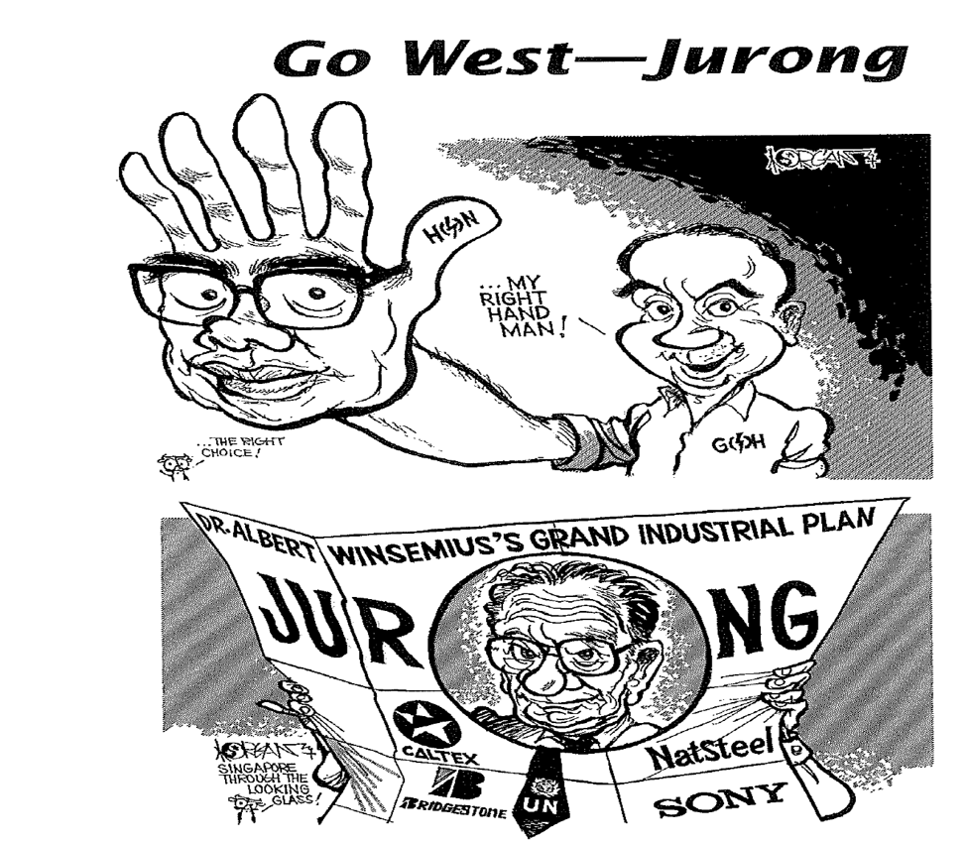
Business and the State
Cartoonist Morgan Chua

Slide 11
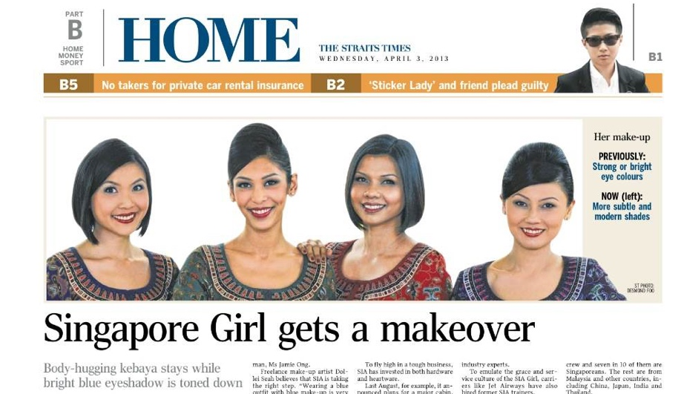
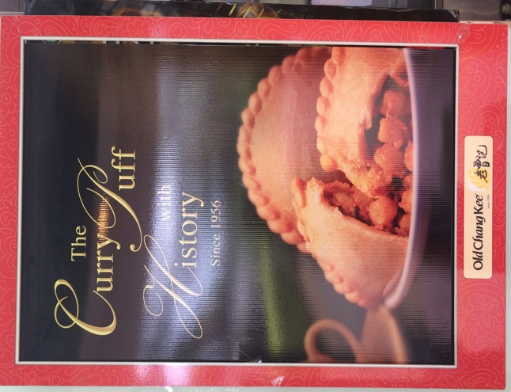
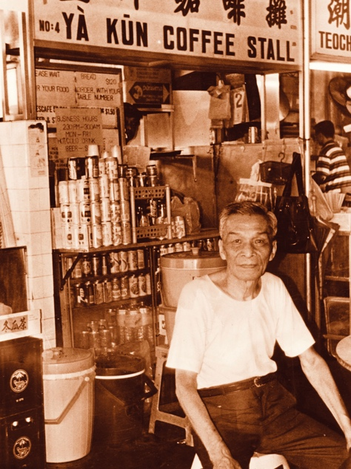
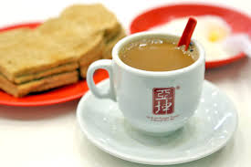
SG Icons and ‘heritage brands’…

Slide 12
OUR AIMS?
To explore Singapore’s history from the perspective of business history.
To trace the development of Singapore and the business communities that contributed to Singapore’s growth.
To explore challenges and changes to Singapore’s business environment from 1819- the present.

